Slide 1
Image Segmentation

Slide 2
Introduction to image segmentation
The purpose of image segmentation is to partition an image into meaningful regions with respect to a particular application
The segmentation is based on measurements taken from the image and might be greylevel, colour, texture, depth or motion

Slide 3
Introduction to image segmentation
Usually image segmentation is an initial and vital step in a series of processes aimed at overall image understanding
Applications of image segmentation include
  Identifying objects in a scene for object-based measurements such as size and shape
  Identifying objects in a moving scene for object-based video compression (MPEG4)
  Identifying objects which are at different distances from a sensor using depth measurements from a laser range finder enabling path planning for a mobile robots

Slide 4
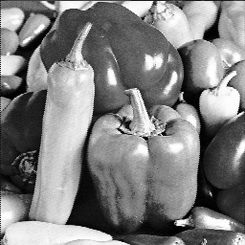
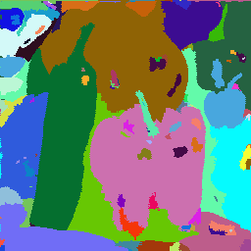
Introduction to image segmentation
Example 1
  Segmentation based on greyscale
  Very simple ‘model’ of greyscale leads to inaccuracies in object labelling

Slide 5
Introduction to image segmentation
Example 2
  Segmentation based on texture
  Enables object surfaces with varying patterns of grey to be segmented

Slide 6
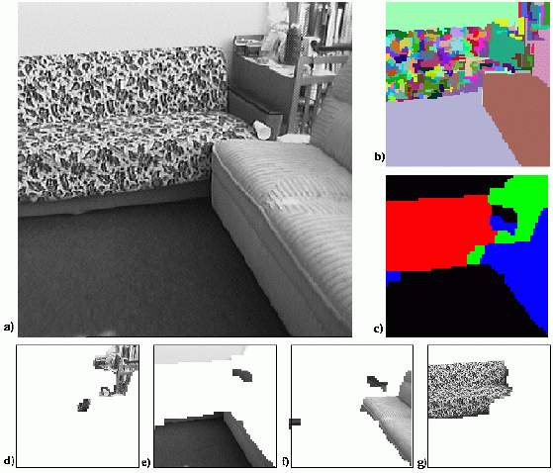
Introduction to image segmentation

Slide 7
Introduction to image segmentation
Example 3
  Segmentation based on motion
  The main difficulty of motion segmentation is that an intermediate step is required to (either implicitly or explicitly) estimate an optical flow field
  The segmentation must be based on this estimate and not, in general, the true flow

Slide 8
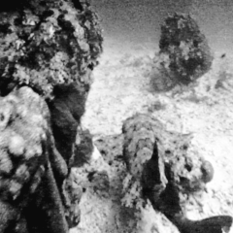

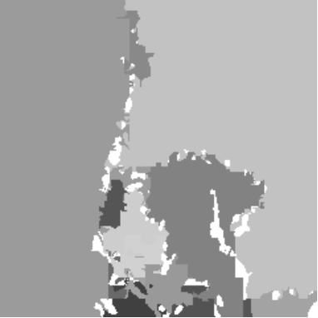
Introduction to image segmentation

Slide 9
Introduction to image segmentation
Example 3
  Segmentation based on depth
  This example shows a range image, obtained with a laser range finder
  A segmentation based on the range (the object distance from the sensor) is useful in guiding mobile robots

Slide 10
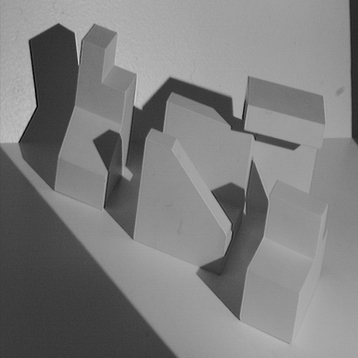
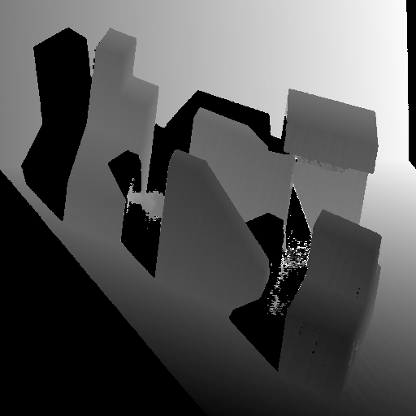
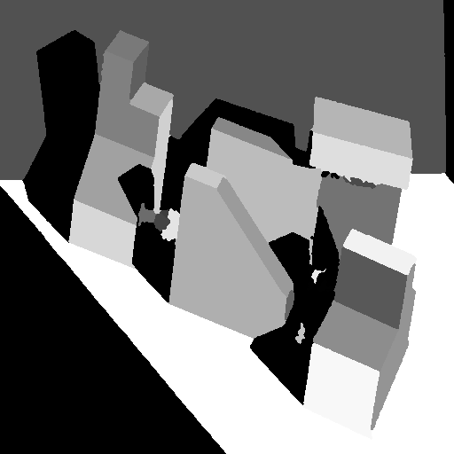
Introduction to image segmentation
Range image
Original image
Segmented image

Slide 11
Greylevel histogram-based segmentation
We will look at two very simple image segmentation techniques that are based on the greylevel histogram of an image
  Thresholding
  Clustering
We will use a very simple object-background test image
  We will consider a zero, low and high noise image

Slide 12

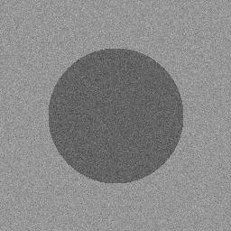
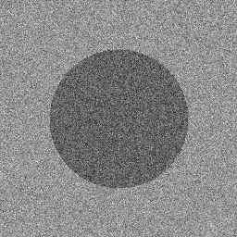
Greylevel histogram-based segmentation
Noise free
Low noise
High noise

Slide 13
Greylevel histogram-based segmentation
How do we characterise low noise and high noise?
We can consider the histograms of our images
  For the noise free image, its simply two spikes at i=100, i=150
  For the low noise image, there are two clear peaks centred on i=100, i=150
  For the high noise image, there is a single peak – two greylevel populations corresponding to object and background have merged

Slide 14
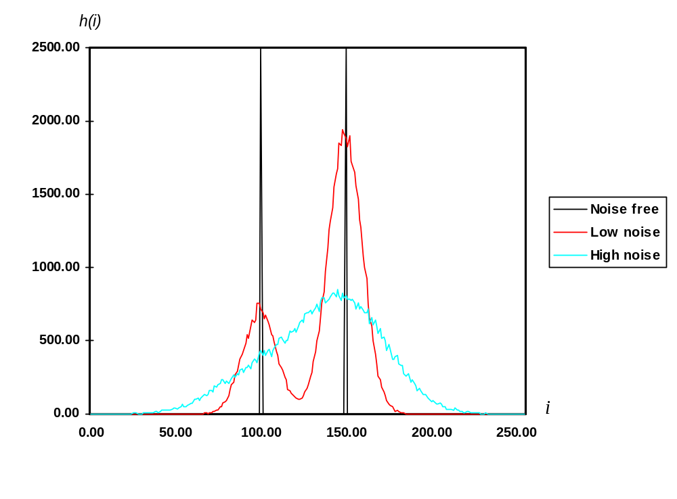
Greylevel histogram-based segmentation

Slide 15
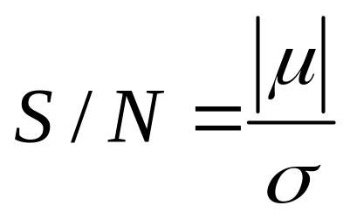
Greylevel histogram-based segmentation
We can define the input image signal-to-noise ratio in terms of the mean greylevel value of the object pixels and background pixels and the additive noise standard deviation

Slide 16
Greylevel histogram-based segmentation
For our test images :
  S/N (noise free) = ∞
  S/N (low noise) = 5
  S/N (low noise) = 2

Slide 17
Greylevel thresholding
We can easily understand segmentation based on thresholding by looking at the histogram of the low noise object/background image
  There is a clear ‘valley’ between to two peaks

Slide 18
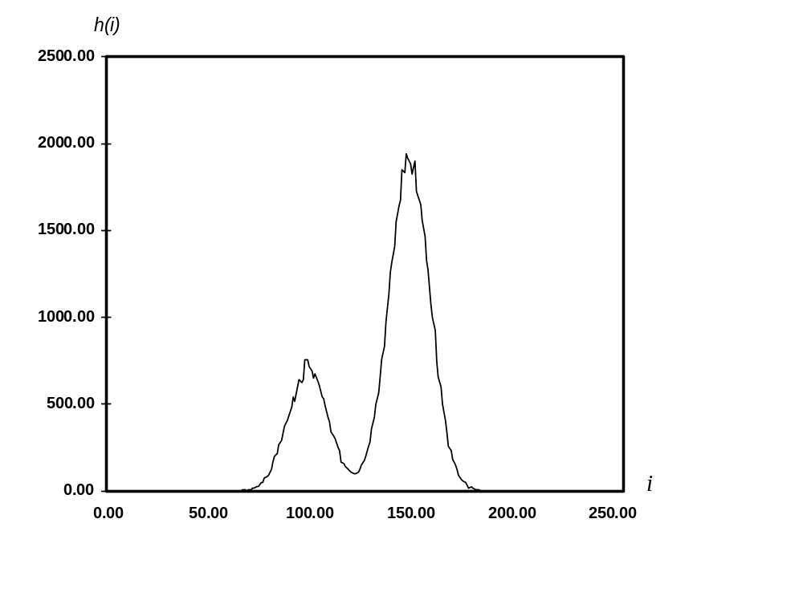
Greylevel thresholding
Background
Object
T

Slide 19
Greylevel thresholding
We can define the greylevel thresholding algorithm as follows:
  If the greylevel of pixel p <=T then pixel p is an object pixel
else
  Pixel p is a background pixel

Slide 20
Greylevel thresholding
This simple threshold test begs the obvious question how do we determine the threshold ?
Many approaches possible
  Interactive threshold
  Adaptive threshold
  Minimisation method

Slide 21
Greylevel thresholding
We will consider in detail a minimisation method for determining the threshold
  Minimisation of the within group variance
  Robot Vision, Haralick & Shapiro, volume 1, page 20

Slide 22
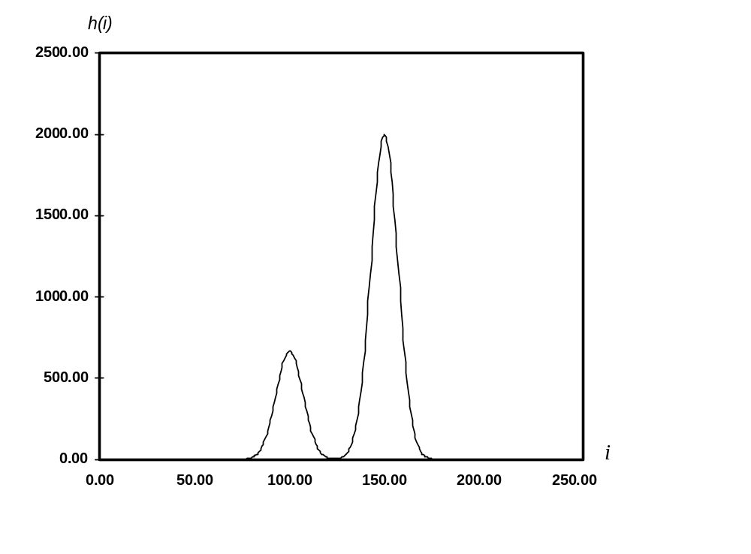
Greylevel thresholding
Idealized object/background image histogram
T

Slide 23
Greylevel thresholding
Any threshold separates the histogram into 2 groups with each group having its own statistics (mean, variance)
The homogeneity of each group is measured by the within group variance
The optimum threshold is that threshold which minimizes the within group variance thus maximizing the homogeneity of each group

Slide 24
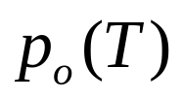
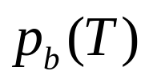
Greylevel thresholding
Let group o (object) be those pixels with greylevel <=T
Let group b (background) be those pixels with greylevel >T
The prior probability of group o is
The prior probability of group b is

Slide 25
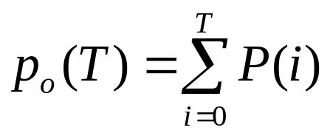
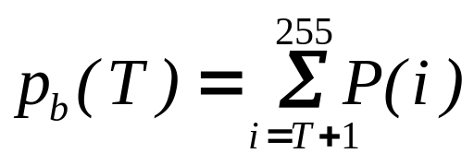
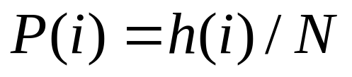
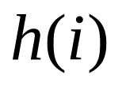
Greylevel thresholding
The following expressions can easily be derived for prior probabilities of object and background
where is the histogram of an N pixel image

Slide 26
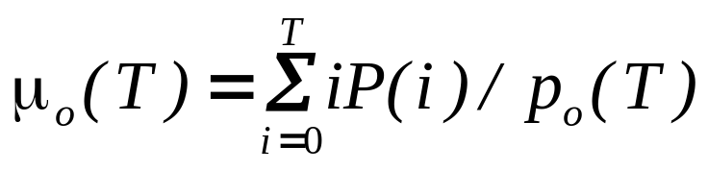
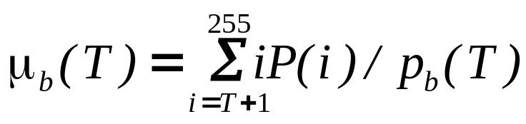
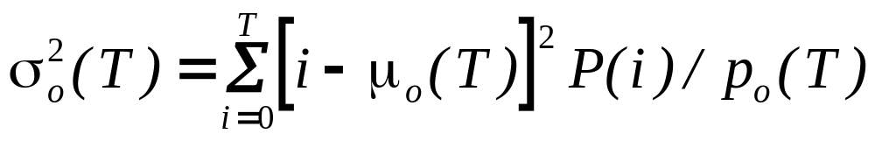
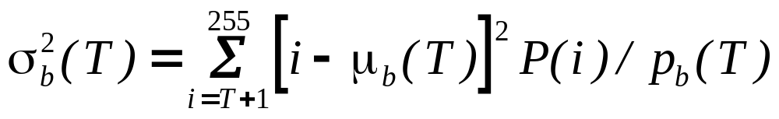
Greylevel thresholding
The mean and variance of each group are as follows :

Slide 27
Greylevel thresholding
The within group variance is defined as :
We determine the optimum T by minimizing this expression with respect to T
  Only requires 256 comparisons for and 8-bit greylevel image

Slide 28

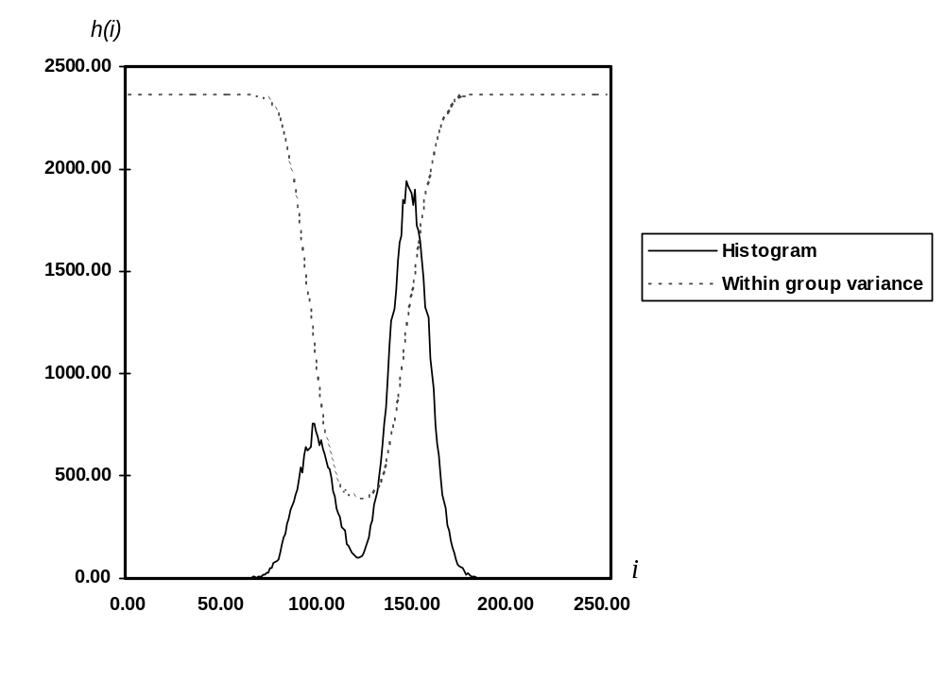
Greylevel thresholding

Slide 29
Greylevel thresholding
We can examine the performance of this algorithm on our low and high noise image
  For the low noise case, it gives an optimum threshold of T=124
  Almost exactly halfway between the object and background peaks
  We can apply this optimum threshold to both the low and high noise images

Slide 30
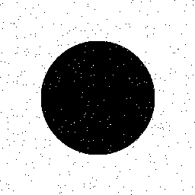
Greylevel thresholding
Low noise image
Thresholded at T=124

Slide 31
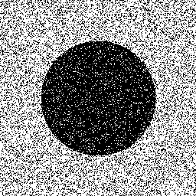
Greylevel thresholding
Low noise image
Thresholded at T=124

Slide 32
Greylevel thresholding
High level of pixel miss-classification noticeable
This is typical performance for thresholding
  The extent of pixel miss-classification is determined by the overlap between object and background histograms.

Slide 33
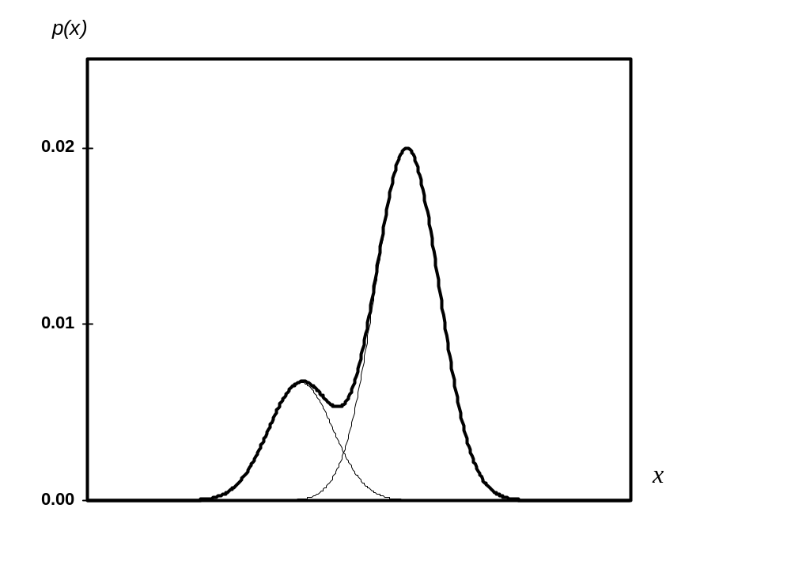



Greylevel thresholding
Background
Object

Slide 34
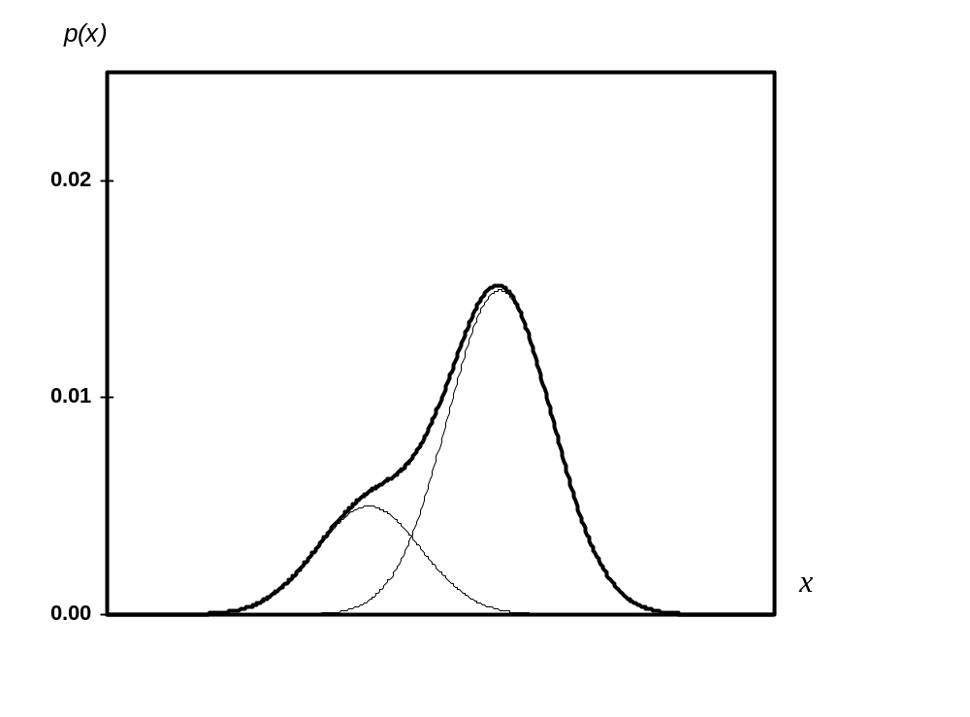
Greylevel thresholding
Background
Object

Slide 35
Greylevel thresholding
Easy to see that, in both cases, for any value of the threshold, object pixels will be miss-classified as background and vice versa
For greater histogram overlap, the pixel miss-classification is obviously greater
  We could even quantify the probability of error in terms of the mean and standard deviations of the object and background histograms

Slide 36
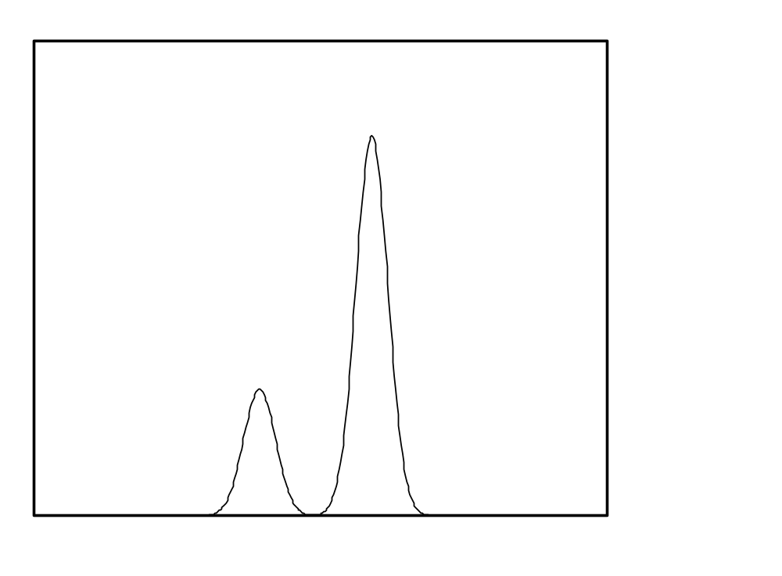


Greylevel clustering
Consider an idealized object/background histogram
Background
Object

Slide 37
Greylevel clustering
Clustering tries to separate the histogram into 2 groups
Defined by two cluster centres c₁ and c₂
  Greylevels classified according to the nearest cluster centre

Slide 38
Greylevel clustering
A nearest neighbour clustering algorithm allows us perform a greylevel segmentation using clustering
  A simple case of a more general and widely used K-means clustering
  A simple iterative algorithm which has known convergence properties

Slide 39
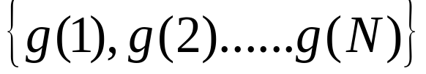


Greylevel clustering
Given a set of greylevels
We can partition this set into two groups

Slide 40
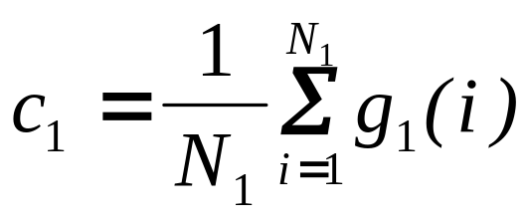
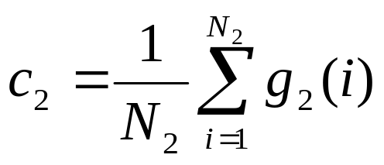
Greylevel clustering
Compute the local means of each group

Slide 41
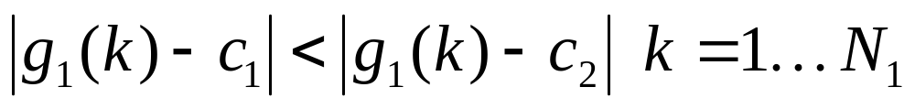
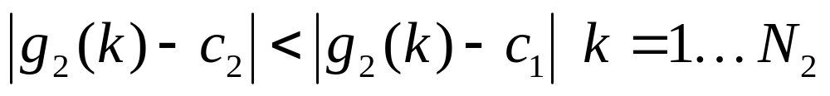


Greylevel clustering
Re-define the new groupings
In other words all grey levels in set 1 are nearer to cluster centre and all grey levels in set 2 are nearer to cluster centre

Slide 42
Greylevel clustering
But, we have a chicken and egg situation
  The problem with the above definition is that each group mean is defined in terms of the partitions and vice versa
  The solution is to define an iterative algorithm and worry about the convergence of the algorithm later

Slide 43




Greylevel clustering
The iterative algorithm is as follows
Initialize the label of each pixel randomly
Repeat
= mean of pixels assigned to object label
= mean of pixels assigned to background label
Compute partition
Compute partition
Until none pixel labelling changes

Slide 44
Greylevel clustering
Two questions to answer
  Does this algorithm converge?
  If so, to what does it converge?
We can show that the algorithm is guaranteed to converge and also that it converges to a sensible result

Slide 45
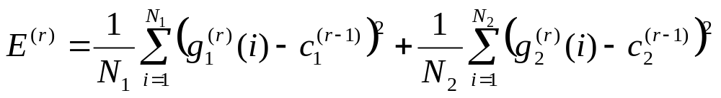

Greylevel clustering
Outline proof of algorithm convergence
  Define a ‘cost function’ at iteration r

Slide 46
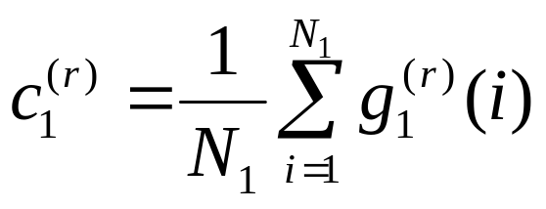
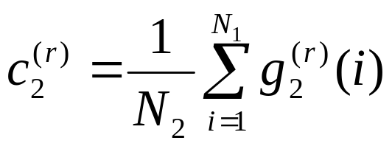
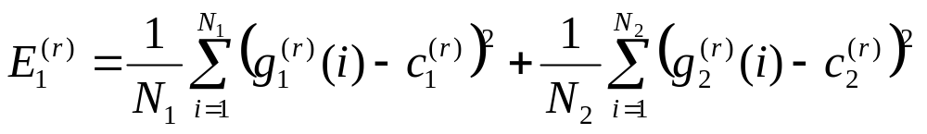
Greylevel clustering
Now update the cluster centres
Finally, update the cost function

Slide 47
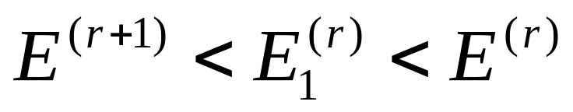
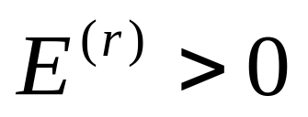
Greylevel clustering
Easy to show that
Since , we conclude that the algorithm must converge
  but
What does the algorithm converge to?

Slide 48
Greylevel clustering
E₁ is simply the sum of the variances within each cluster which is minimised at convergence
  Gives sensible results for well separated clusters
  Similar performance to thresholding

Slide 49
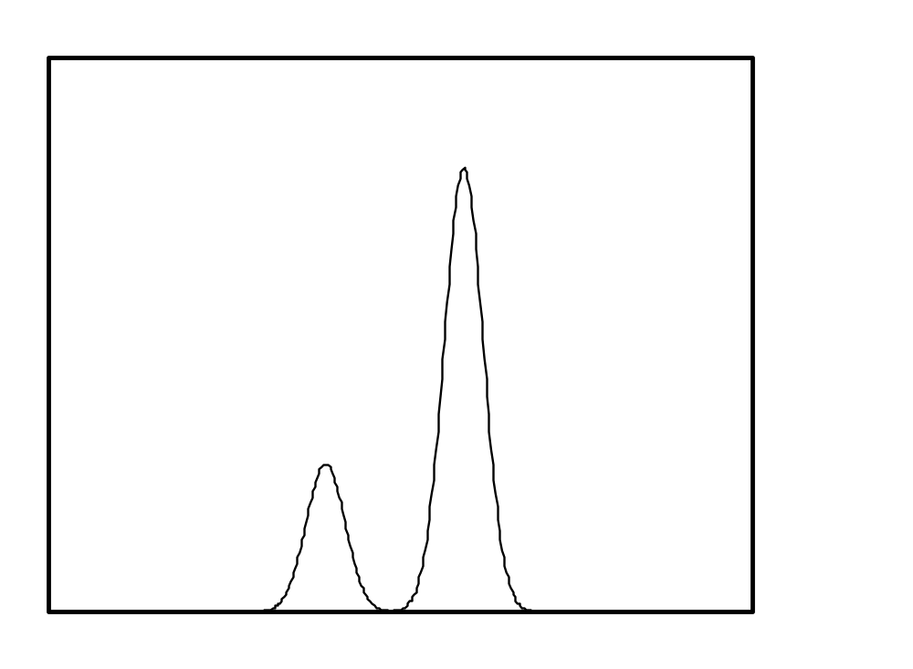



Greylevel clustering

